Slide 1
Vehicle maintenance prediction
DSCI-6601-001 Practical Machine Learning
Sahil Khan - 202482066

Slide 2
introduction
The field of predictive maintenance is expanding quickly and has the potential to save costs, increase operational effectiveness, and improve safety in a variety of industries. The objective of this project is to create a machine learning model that can forecast whether maintenance is required for a vehicle based on a number of characteristics, such as component status, usage patterns, maintenance history, and vehicle specs. Accurately predicting future maintenance requirements enables fleet managers and car owners to plan maintenance in advance, reducing downtime, avoiding expensive malfunctions, and improving safety.

Slide 3
Problem statement
Implement AI predictive maintenance for vehicles.
Utilize incoming data to anticipate and prevent disruptions.
Minimize downtime and reduce maintenance costs.
Enhance vehicle reliability for uninterrupted operations.
Optimize maintenance schedules for efficient transportation.

Slide 4
Objective
Predicting Maintenance Needs
Build a classification model to identify whether a vehicle requires maintenance based on historical and operational data.
Optimizing Fuel Efficiency
Develop a regression model to provide actionable insights for maintaining or improving vehicle fuel efficiency by analyzing key influencing factors.

Slide 5
dataset
Attributes
Vehicle Model
Mileage
Maintenance History
Reported Issues
Vehicle Age
Fuel Type
Transmission Type
Engine Size
Odometer Reading
Last Service Date
Warranty Expiry Date
Owner Type
Insurance Premium
Service History
Accident History
Fuel Efficiency
Tire Condition
Brake Condition
Battery Status
Need Maintenance
Dimension
Columns: 20
Samples: 5000
Distribution of Need_Maintenance
False [0]: 9502 (19%)
True [1]: 40,498 (81%)
Summary Stats: Fuel Efficiency
count 50000.000000
mean 14.990323
std 2.885583
min 10.000098
25% 12.489037
50% 14.986352
75% 17.474676
max 19.999968

Slide 6
Data preprocessing
Key Features
Step1: Handle Missing Values
Step2: Drop Duplicates
Step3: Feature Engineering
Step4: Applying Feature Scaling for Numerical Features and One-Hot Encoding for Categorical Features
Step5: Data Split in 75:25 ratio to train-test sets using StratifiedShuffleSplit to ensure balance and avoid skewness.

Slide 7
ML Algorithms
CLASSIFIER
Logistic Regression
Random Forest Classifier
SGD Classifier
Decision Tree Classifier
XGB Classifier
REGRESSOR
Linear Regression
Ridge Regression
Random Forest Regressor
Gradient Boosting Regressor
XGB Regressor

Slide 8
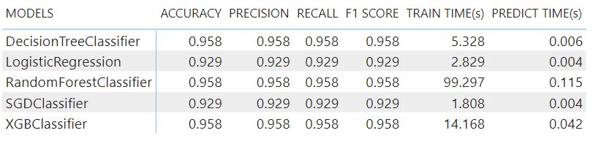
Model metrics
Classifiers

Slide 9
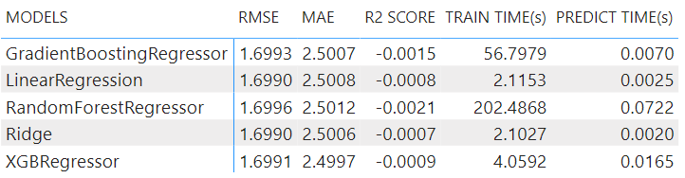
Model metrics
Regressor

Slide 10
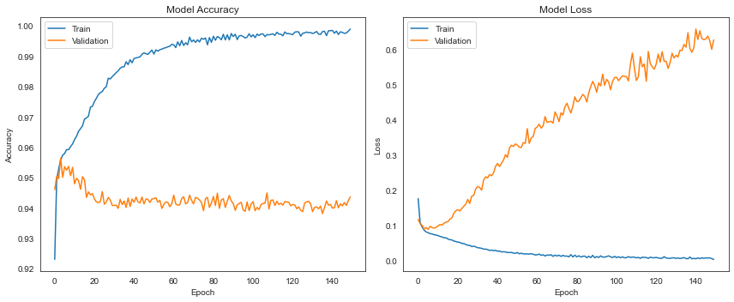
Model metrics
Neural Network Classifier

Slide 11
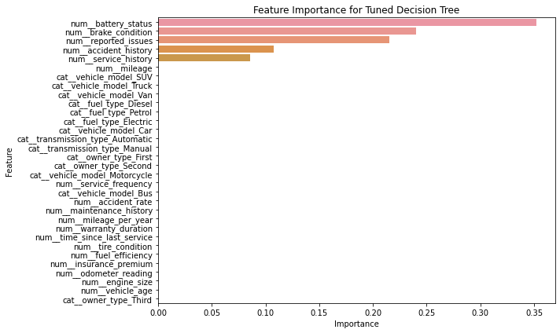
Feature importance
TOP FEATURES
Battery Status
Brake Condition
Reported Issue
Accident History
Service History

Slide 12
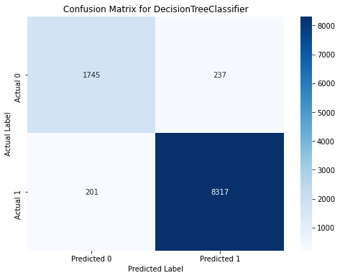
Best Models
Classifier
Decision Tree
Best Params: {'criterion': 'gini’,
'max_depth': 5,
'min_samples_leaf': 1,
'min_samples_split': 2}
Accuracy: 0.958285714
Precision: 0.958026574
Recall: 0.958285714
F1 Score: 0.958138541

Slide 13
Best Models
Regressor
Ridge Regressor
Best Params: {{'alpha': 10.0,
'max_iter': 1000,
'solver': 'auto’}
RMSE: 1.698994548
MAE: 2.500581049
R2 Score: -0.000674967

Slide 14
Prediction: user input

Slide 15
Thank You
Sahil Khan
202482066
Project Link: https://github.com/sahil82764/Vehicle_Maintenance_Prediction

